Slide 1
0 | 0 | 1 | 0
0 | 1 | 0.5 | 0
0 | 0.5 | 1 | 0.5
0.5 | 1 | 0.5 | 1
0
0
0
0.5
0
0
0
0.5
0
1
0.5
1
0
1
0.5
1
1
0.5
1
0.5
1
0.5
1
0.5
0
0
0.5
1
0
0
0.5
1

Slide 2
+
+
+
+
–
+
–
+
+
–
–
–
+
–

Slide 3
–
+
+
+
–
–
–
–
–
–
+
+
–
–
–
+
–
+
–
–
+
+
–
+
+
–
+
–
+
–
+
+
–
–
+
+
+
–
+
–
–
–
+
+
+
–
–
–
+
+
+
+
+
+
–
–
+
+
+
+
–
+
+
–
+
–
–
–
–
+
–
+
–
–
–
–
+
–
–
–
+
+
–
–
–
–
–
–
–
+
+
–
–
–
–
–
–
+
+
–
–

Slide 4
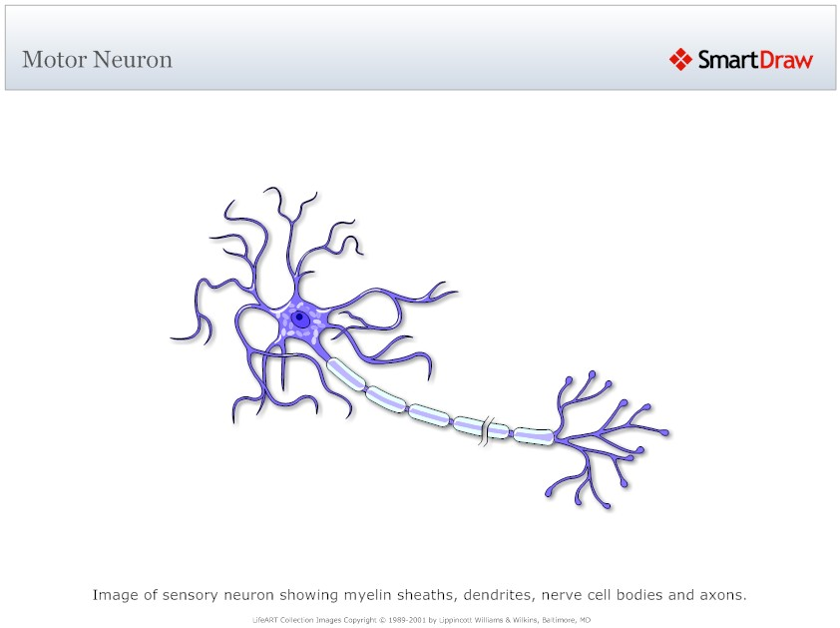
Inputs
Strengths
dendrites
Sum
Transform
Output

Slide 5
synaptic terminal
dendrites
cell body
axon
Inputs
Strengths
Sum
Transform
Output

Slide 6
0 | 0 | 1 | 0
0 | 1 | 0.5 | 0
0 | 0.5 | 1 | 0.5
0.5 | 1 | 0.5 | 1

Slide 8
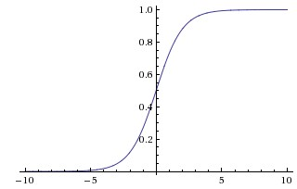

Slide 9
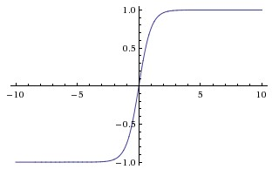

Slide 10
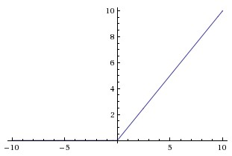

Slide 14


Slide 15
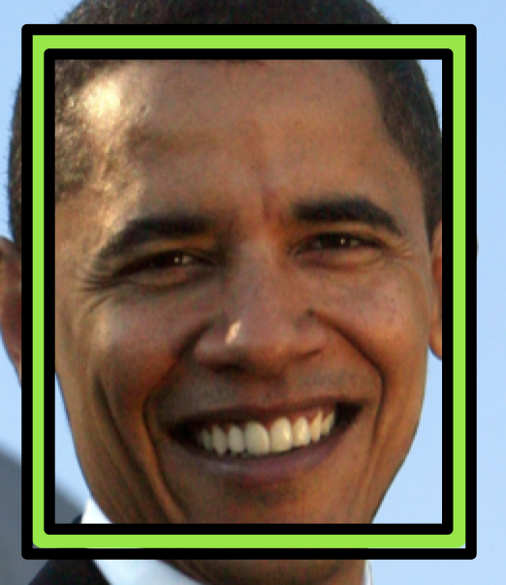

Slide 17
d
w
h

Slide 18
?

Slide 20
Feature Map
Filter

Slide 21
Filter
1
-1
2
8
7
-7
-2
5
8
-7
5
1
5
3
-4
2
2
-1
1
5
3
-4
2
2
-1
S = 1
S = 2

Slide 22
0 | 0 | 0 | 0 | 0 | 0 | 0
0 | -1 | 1 | 1 | 1 | -1 | 0
0 | 1 | -1 | 1 | 1 | -1 | 0
0 | 0 | -1 | 1 | 1 | 0 | 0
0 | -1 | 1 | 1 | 1 | 0 | 0
0 | 1 | 1 | -1 | 1 | -1 | 0
0 | 0 | 0 | 0 | 0 | 0 | 0
0 | 0 | 0
0 | -1 | 1
0 | 1 | -1
1 | 0 | 0
0 | 1 | 1
1 | -1 | -1
0 | 0 | 0 | 0 | 0 | 0 | 0
0 | 1 | -1 | -1 | 1 | -1 | 0
0 | 1 | -1 | 0 | 1 | -1 | 0
0 | 1 | 0 | 0 | -1 | 0 | 0
0 | -1 | 1 | 1 | 1 | 1 | 0
0 | -1 | 1 | 0 | -1 | -1 | 0
0 | 0 | 0 | 0 | 0 | 0 | 0
7 | -3 | -2
-3 | 1 | 3
-2 | 4 | 2
1 | 0 | 0
0 | 0 | -1
0 | 1 | 1
1 | 1 | 0
1 | 1 | -1
1 | -1 | -1
3 | -6 | 3
1 | -1 | 2
-1 | 5 | 0
0 | 0 | 0 | 0 | 0 | 0 | 0
0 | 1 | -1 | -1 | 0 | -1 | 0
0 | 1 | -1 | 0 | 1 | 0 | 0
0 | 1 | 0 | 0 | -1 | 0 | 0
0 | 0 | 1 | 0 | 0 | 1 | 0
0 | -1 | -1 | 1 | -1 | 0 | 0
0 | 0 | 0 | 0 | 0 | 0 | 0
1 | 1 | 1
1 | 1 | 1
0 | 1 | -1
0 | 0 | 0
0 | 0 | 0
0 | 1 | 0

Slide 23
0 | 0 | 0 | 0 | 0 | 0 | 0
0 | -1 | 1 | 1 | 1 | -1 | 0
0 | 1 | -1 | 1 | 1 | -1 | 0
0 | 0 | -1 | 1 | 1 | 0 | 0
0 | -1 | 1 | 1 | 1 | 0 | 0
0 | 1 | 1 | -1 | 1 | -1 | 0
0 | 0 | 0 | 0 | 0 | 0 | 0
0 | 0 | 0
0 | -1 | 1
0 | 1 | -1
1 | 0 | 0
0 | 1 | 1
1 | -1 | -1
0 | 0 | 0 | 0 | 0 | 0 | 0
0 | 1 | -1 | -1 | 1 | -1 | 0
0 | 1 | -1 | 0 | 1 | -1 | 0
0 | 1 | 0 | 0 | -1 | 0 | 0
0 | -1 | 1 | 1 | 1 | 1 | 0
0 | -1 | 1 | 0 | -1 | -1 | 0
0 | 0 | 0 | 0 | 0 | 0 | 0
7 | -3 | -2
-3 | 1 | 3
-2 | 4 | 2
1 | 0 | 0
0 | 0 | -1
0 | 1 | 1
1 | 1 | 0
1 | 1 | -1
1 | -1 | -1
3 | -6 | 3
1 | -1 | 2
-1 | 5 | 0
0 | 0 | 0 | 0 | 0 | 0 | 0
0 | 1 | -1 | -1 | 0 | -1 | 0
0 | 1 | -1 | 0 | 1 | 0 | 0
0 | 1 | 0 | 0 | -1 | 0 | 0
0 | 0 | 1 | 0 | 0 | 1 | 0
0 | -1 | -1 | 1 | -1 | 0 | 0
0 | 0 | 0 | 0 | 0 | 0 | 0
1 | 1 | 1
1 | 1 | 1
0 | 1 | -1
0 | 0 | 0
0 | 0 | 0
0 | 1 | 0

Slide 24
0 | 0 | 0 | 0 | 0 | 0 | 0
0 | -1 | 1 | 1 | 1 | -1 | 0
0 | 1 | -1 | 1 | 1 | -1 | 0
0 | 0 | -1 | 1 | 1 | 0 | 0
0 | -1 | 1 | 1 | 1 | 0 | 0
0 | 1 | 1 | -1 | 1 | -1 | 0
0 | 0 | 0 | 0 | 0 | 0 | 0
0 | 0 | 0
0 | -1 | 1
0 | 1 | -1
1 | 0 | 0
0 | 1 | 1
1 | -1 | -1
0 | 0 | 0 | 0 | 0 | 0 | 0
0 | 1 | -1 | -1 | 1 | -1 | 0
0 | 1 | -1 | 0 | 1 | -1 | 0
0 | 1 | 0 | 0 | -1 | 0 | 0
0 | -1 | 1 | 1 | 1 | 1 | 0
0 | -1 | 1 | 0 | -1 | -1 | 0
0 | 0 | 0 | 0 | 0 | 0 | 0
7 | -3 | -2
-3 | 1 | 3
-2 | 4 | 2
1 | 0 | 0
0 | 0 | -1
0 | 1 | 1
1 | 1 | 0
1 | 1 | -1
1 | -1 | -1
3 | -6 | 3
1 | -1 | 2
-1 | 5 | 0
0 | 0 | 0 | 0 | 0 | 0 | 0
0 | 1 | -1 | -1 | 0 | -1 | 0
0 | 1 | -1 | 0 | 1 | 0 | 0
0 | 1 | 0 | 0 | -1 | 0 | 0
0 | 0 | 1 | 0 | 0 | 1 | 0
0 | -1 | -1 | 1 | -1 | 0 | 0
0 | 0 | 0 | 0 | 0 | 0 | 0
1 | 1 | 1
1 | 1 | 1
0 | 1 | -1
0 | 0 | 0
0 | 0 | 0
0 | 1 | 0

Slide 25
0 | 0 | 0 | 0 | 0 | 0 | 0
0 | -1 | 1 | 1 | 1 | -1 | 0
0 | 1 | -1 | 1 | 1 | -1 | 0
0 | 0 | -1 | 1 | 1 | 0 | 0
0 | -1 | 1 | 1 | 1 | 0 | 0
0 | 1 | 1 | -1 | 1 | -1 | 0
0 | 0 | 0 | 0 | 0 | 0 | 0
0 | 0 | 0
0 | -1 | 1
0 | 1 | -1
1 | 0 | 0
0 | 1 | 1
1 | -1 | -1
0 | 0 | 0 | 0 | 0 | 0 | 0
0 | 1 | -1 | -1 | 1 | -1 | 0
0 | 1 | -1 | 0 | 1 | -1 | 0
0 | 1 | 0 | 0 | -1 | 0 | 0
0 | -1 | 1 | 1 | 1 | 1 | 0
0 | -1 | 1 | 0 | -1 | -1 | 0
0 | 0 | 0 | 0 | 0 | 0 | 0
7 | -3 | -2
-3 | 1 | 3
-2 | 4 | 2
1 | 0 | 0
0 | 0 | -1
0 | 1 | 1
1 | 1 | 0
1 | 1 | -1
1 | -1 | -1
3 | -6 | 3
1 | -1 | 2
-1 | 5 | 0
0 | 0 | 0 | 0 | 0 | 0 | 0
0 | 1 | -1 | -1 | 0 | -1 | 0
0 | 1 | -1 | 0 | 1 | 0 | 0
0 | 1 | 0 | 0 | -1 | 0 | 0
0 | 0 | 1 | 0 | 0 | 1 | 0
0 | -1 | -1 | 1 | -1 | 0 | 0
0 | 0 | 0 | 0 | 0 | 0 | 0
1 | 1 | 1
1 | 1 | 1
0 | 1 | -1
0 | 0 | 0
0 | 0 | 0
0 | 1 | 0

Slide 26
0 | 0 | 0 | 0 | 0 | 0 | 0
0 | -1 | 1 | 1 | 1 | -1 | 0
0 | 1 | -1 | 1 | 1 | -1 | 0
0 | 0 | -1 | 1 | 1 | 0 | 0
0 | -1 | 1 | 1 | 1 | 0 | 0
0 | 1 | 1 | -1 | 1 | -1 | 0
0 | 0 | 0 | 0 | 0 | 0 | 0
0 | 0 | 0
0 | -1 | 1
0 | 1 | -1
1 | 0 | 0
0 | 1 | 1
1 | -1 | -1
0 | 0 | 0 | 0 | 0 | 0 | 0
0 | 1 | -1 | -1 | 1 | -1 | 0
0 | 1 | -1 | 0 | 1 | -1 | 0
0 | 1 | 0 | 0 | -1 | 0 | 0
0 | -1 | 1 | 1 | 1 | 1 | 0
0 | -1 | 1 | 0 | -1 | -1 | 0
0 | 0 | 0 | 0 | 0 | 0 | 0
7 | -3 | -2
-3 | 1 | 3
-2 | 4 | 2
1 | 0 | 0
0 | 0 | -1
0 | 1 | 1
1 | 1 | 0
1 | 1 | -1
1 | -1 | -1
3 | -6 | 3
1 | -1 | 2
-1 | 5 | 0
0 | 0 | 0 | 0 | 0 | 0 | 0
0 | 1 | -1 | -1 | 0 | -1 | 0
0 | 1 | -1 | 0 | 1 | 0 | 0
0 | 1 | 0 | 0 | -1 | 0 | 0
0 | 0 | 1 | 0 | 0 | 1 | 0
0 | -1 | -1 | 1 | -1 | 0 | 0
0 | 0 | 0 | 0 | 0 | 0 | 0
1 | 1 | 1
1 | 1 | 1
0 | 1 | -1
0 | 0 | 0
0 | 0 | 0
0 | 1 | 0

Slide 27
0 | 0 | 0 | 0 | 0 | 0 | 0
0 | -1 | 1 | 1 | 1 | -1 | 0
0 | 1 | -1 | 1 | 1 | -1 | 0
0 | 0 | -1 | 1 | 1 | 0 | 0
0 | -1 | 1 | 1 | 1 | 0 | 0
0 | 1 | 1 | -1 | 1 | -1 | 0
0 | 0 | 0 | 0 | 0 | 0 | 0
0 | 0 | 0
0 | -1 | 1
0 | 1 | -1
1 | 0 | 0
0 | 1 | 1
1 | -1 | -1
0 | 0 | 0 | 0 | 0 | 0 | 0
0 | 1 | -1 | -1 | 1 | -1 | 0
0 | 1 | -1 | 0 | 1 | -1 | 0
0 | 1 | 0 | 0 | -1 | 0 | 0
0 | -1 | 1 | 1 | 1 | 1 | 0
0 | -1 | 1 | 0 | -1 | -1 | 0
0 | 0 | 0 | 0 | 0 | 0 | 0
7 | -3 | -2
-3 | 1 | 3
-2 | 4 | 2
1 | 0 | 0
0 | 0 | -1
0 | 1 | 1
1 | 1 | 0
1 | 1 | -1
1 | -1 | -1
3 | -6 | 3
1 | -1 | 2
-1 | 5 | 0
0 | 0 | 0 | 0 | 0 | 0 | 0
0 | 1 | -1 | -1 | 0 | -1 | 0
0 | 1 | -1 | 0 | 1 | 0 | 0
0 | 1 | 0 | 0 | -1 | 0 | 0
0 | 0 | 1 | 0 | 0 | 1 | 0
0 | -1 | -1 | 1 | -1 | 0 | 0
0 | 0 | 0 | 0 | 0 | 0 | 0
1 | 1 | 1
1 | 1 | 1
0 | 1 | -1
0 | 0 | 0
0 | 0 | 0
0 | 1 | 0

Slide 28
0 | 0 | 0 | 0 | 0 | 0 | 0
0 | -1 | 1 | 1 | 1 | -1 | 0
0 | 1 | -1 | 1 | 1 | -1 | 0
0 | 0 | -1 | 1 | 1 | 0 | 0
0 | -1 | 1 | 1 | 1 | 0 | 0
0 | 1 | 1 | -1 | 1 | -1 | 0
0 | 0 | 0 | 0 | 0 | 0 | 0
0 | 0 | 0
0 | -1 | 1
0 | 1 | -1
1 | 0 | 0
0 | 1 | 1
1 | -1 | -1
0 | 0 | 0 | 0 | 0 | 0 | 0
0 | 1 | -1 | -1 | 1 | -1 | 0
0 | 1 | -1 | 0 | 1 | -1 | 0
0 | 1 | 0 | 0 | -1 | 0 | 0
0 | -1 | 1 | 1 | 1 | 1 | 0
0 | -1 | 1 | 0 | -1 | -1 | 0
0 | 0 | 0 | 0 | 0 | 0 | 0
7 | -3 | -2
-3 | 1 | 3
-2 | 4 | 2
1 | 0 | 0
0 | 0 | -1
0 | 1 | 1
1 | 1 | 0
1 | 1 | -1
1 | -1 | -1
3 | -6 | 3
1 | -1 | 2
-1 | 5 | 0
0 | 0 | 0 | 0 | 0 | 0 | 0
0 | 1 | -1 | -1 | 0 | -1 | 0
0 | 1 | -1 | 0 | 1 | 0 | 0
0 | 1 | 0 | 0 | -1 | 0 | 0
0 | 0 | 1 | 0 | 0 | 1 | 0
0 | -1 | -1 | 1 | -1 | 0 | 0
0 | 0 | 0 | 0 | 0 | 0 | 0
1 | 1 | 1
1 | 1 | 1
0 | 1 | -1
0 | 0 | 0
0 | 0 | 0
0 | 1 | 0

Slide 29
0 | 0 | 0 | 0 | 0 | 0 | 0
0 | -1 | 1 | 1 | 1 | -1 | 0
0 | 1 | -1 | 1 | 1 | -1 | 0
0 | 0 | -1 | 1 | 1 | 0 | 0
0 | -1 | 1 | 1 | 1 | 0 | 0
0 | 1 | 1 | -1 | 1 | -1 | 0
0 | 0 | 0 | 0 | 0 | 0 | 0
0 | 0 | 0
0 | -1 | 1
0 | 1 | -1
1 | 0 | 0
0 | 1 | 1
1 | -1 | -1
0 | 0 | 0 | 0 | 0 | 0 | 0
0 | 1 | -1 | -1 | 1 | -1 | 0
0 | 1 | -1 | 0 | 1 | -1 | 0
0 | 1 | 0 | 0 | -1 | 0 | 0
0 | -1 | 1 | 1 | 1 | 1 | 0
0 | -1 | 1 | 0 | -1 | -1 | 0
0 | 0 | 0 | 0 | 0 | 0 | 0
7 | -3 | -2
-3 | 1 | 3
-2 | 4 | 2
1 | 0 | 0
0 | 0 | -1
0 | 1 | 1
1 | 1 | 0
1 | 1 | -1
1 | -1 | -1
3 | -6 | 3
1 | -1 | 2
-1 | 5 | 0
0 | 0 | 0 | 0 | 0 | 0 | 0
0 | 1 | -1 | -1 | 0 | -1 | 0
0 | 1 | -1 | 0 | 1 | 0 | 0
0 | 1 | 0 | 0 | -1 | 0 | 0
0 | 0 | 1 | 0 | 0 | 1 | 0
0 | -1 | -1 | 1 | -1 | 0 | 0
0 | 0 | 0 | 0 | 0 | 0 | 0
1 | 1 | 1
1 | 1 | 1
0 | 1 | -1
0 | 0 | 0
0 | 0 | 0
0 | 1 | 0

Slide 31

?

Slide 32
tf.random_normal
tf.assign
weights

Slide 33
output
tf.add
biases
tf.matmul
W
x

Slide 34
/cpu:0
tf.add_n
/gpu:0
/gpu:1
tf.matmul
tf.matmul
a
b
a
b

Slide 35
tf..nn.relu
tf.add
output/biases
tf.matmul
output/W
tf..nn.relu
tf.add
hidden_2/biases
tf.matmul
hidden_2/W
tf..nn.relu
tf.add
hidden_1/biases
tf.matmul
hidden_1/W
x

Slide 36
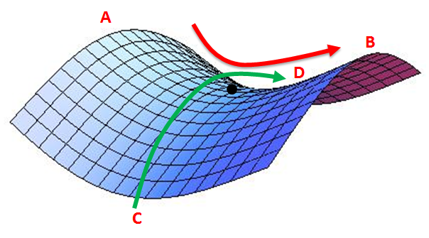
A
B
D
C

Slide 39
softmax
fc
fc
pool
conv
softmax
conv
fc
conv
softmax
fc
(repeated 3 times)
fc
pool
pool
softmax
pool
conv
conv
fc
conv
conv
conv
conv
(repeated 1-2 times)
(repeated 3-4 times)
(repeated 2 times)
input
input
input
input

Slide 40
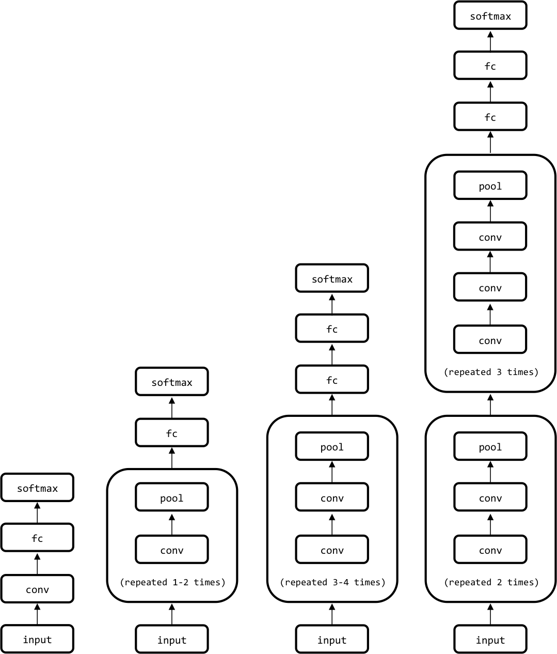

Slide 42
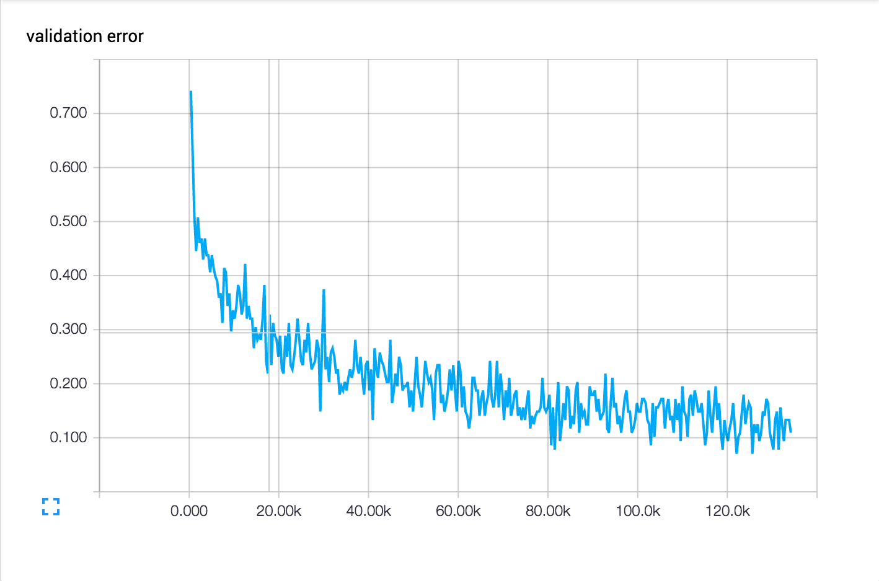
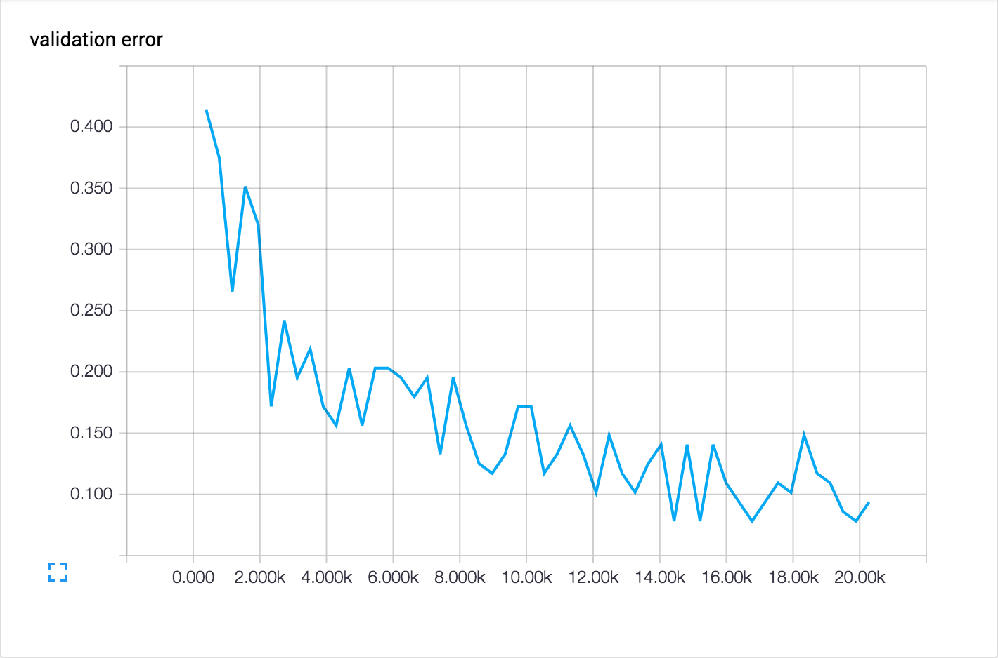

Slide 44
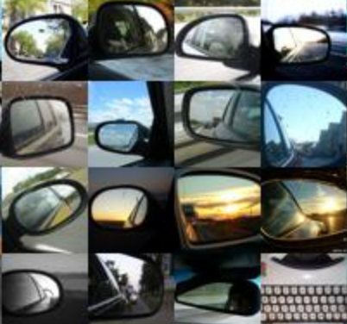

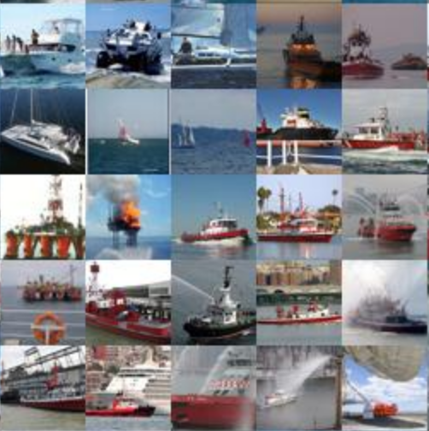
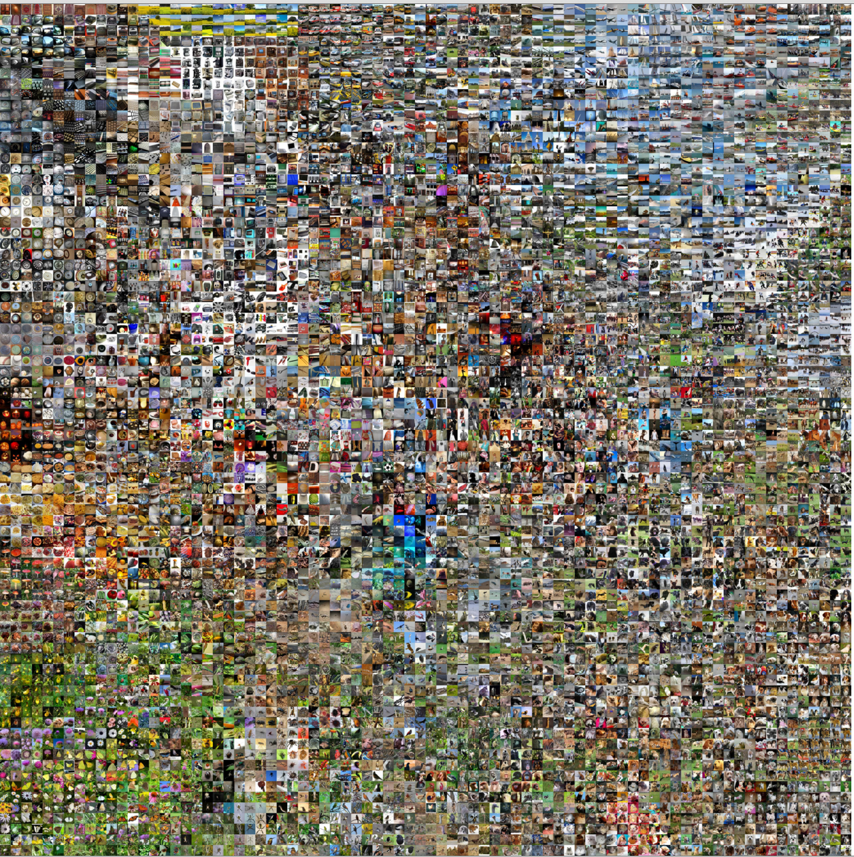
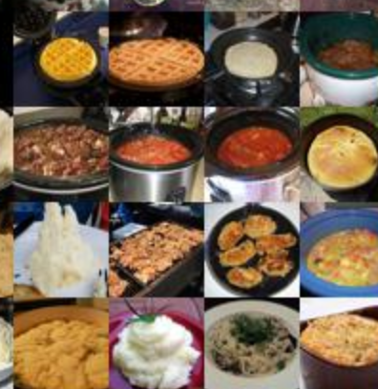
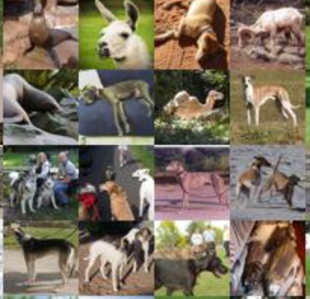
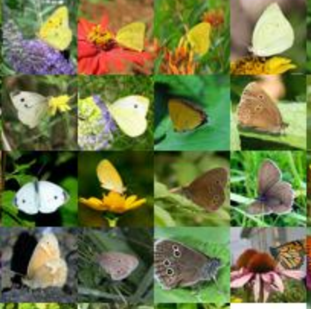
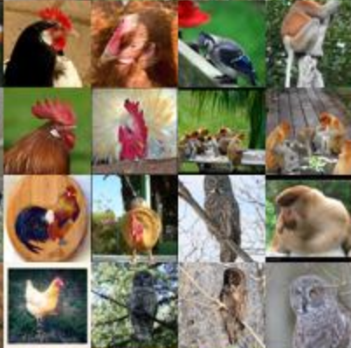
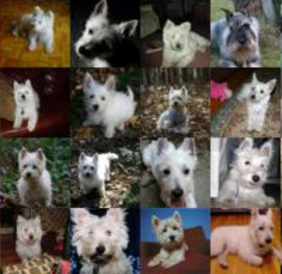

Slide 46




Slide 47
embedding algorithm
(unsupervised with lots of data)
input
embedding
predictive algorithm
(supervised with less data)
embedding
output

Slide 49
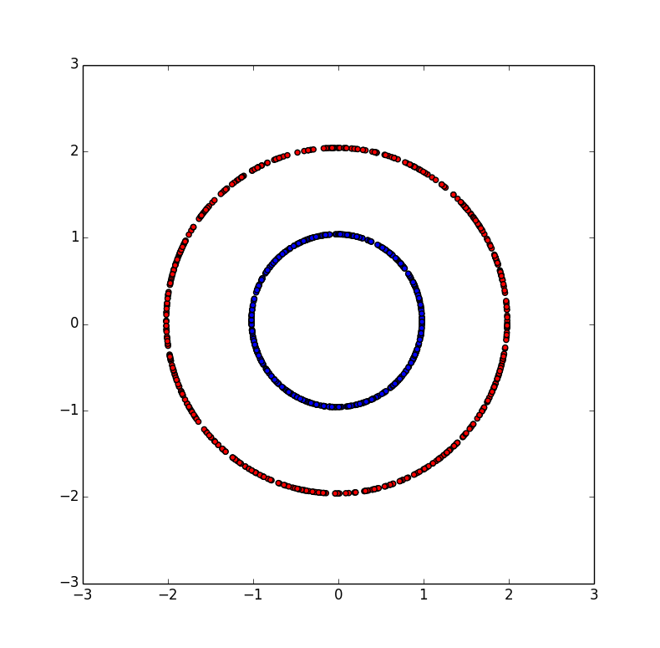
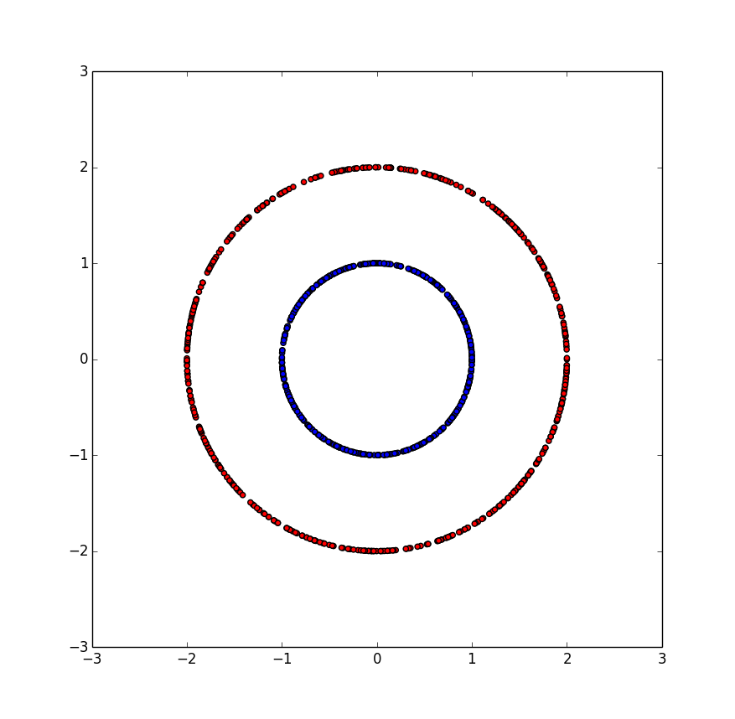
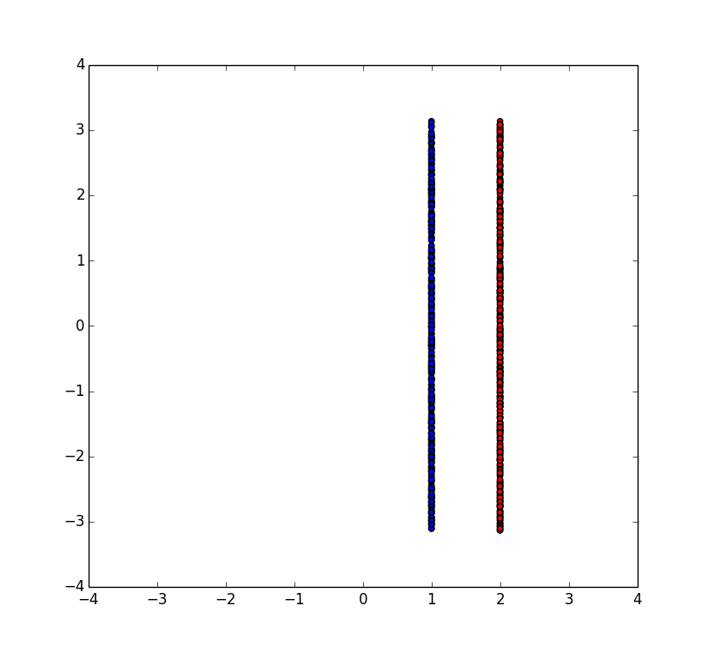
PCA
Polar Transform

Slide 50
encoder
decoder
input
embedding
Reconstructed input

